Slide 1



Description of the method of chemical equilibrium in solutions. Dissolution and solubility.
Al-Farabi Kazakh National University
Faculty of Chemistry and Chemical technology
Department of General and Inorganic Chemistry
pHd Bakhadur askar

Slide 2
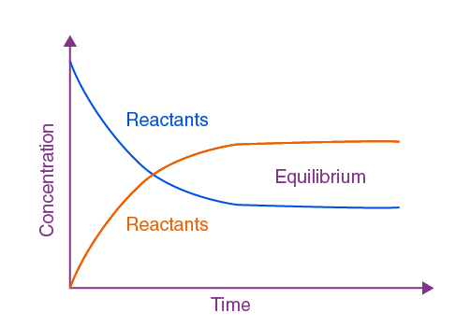

Concept of chemical equilibrium in solutions
In aqueous systems, chemical equilibrium describes a state in which the rate of the forward process (dissolution) equals the rate of the reverse process (precipitation).
$AB_{\left(s\right)}⇌A_{\left(aq\right)}^{+}+B_{\left(aq\right)}^{−}$
At equilibrium, the concentration of dissolved ions remains constant because the dynamic exchange between the solid and ions in solution continues at equal rates.
This equilibrium is crucial for understanding solubility, buffer systems, and reactions in biological and environmental chemistry.

Slide 3
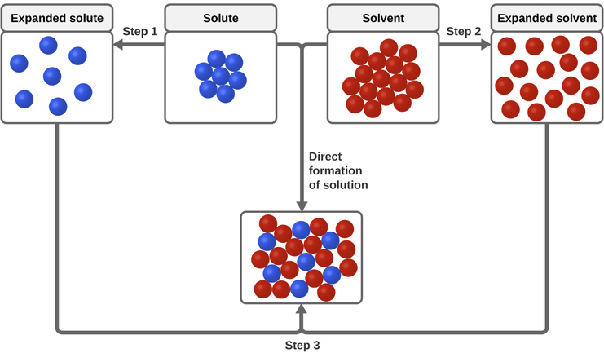

The process of dissolution
Dissolution involves breaking intermolecular or ionic forces within a solute and forming new interactions with solvent molecules.
Ionic compounds dissociate into cations and anions, stabilized by solvation (hydration in water).
Molecular solutes (e.g., ethanol, sugar) dissolve via hydrogen bonding and dipole–dipole interactions.
The dissolution process is influenced by enthalpy (ΔH) and entropy (ΔS) changes. The Gibbs free energy (ΔG) determines spontaneity:
If ΔG < 0, the dissolution is spontaneous.
$$ΔG=ΔH−TΔS$$

Slide 4
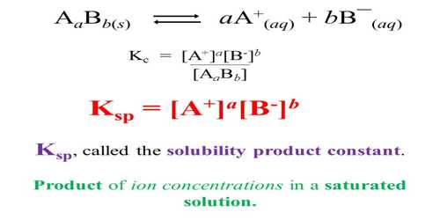
The solubility product constant (Ksp)
The Ksp value quantifies the extent to which a compound dissolves in water.
A large Ksp means high solubility, while a small Ksp indicates low solubility.
The solubility equilibrium depends on temperature but is independent of the amount of solid present — as long as undissolved solid remains, equilibrium persists.

Slide 5
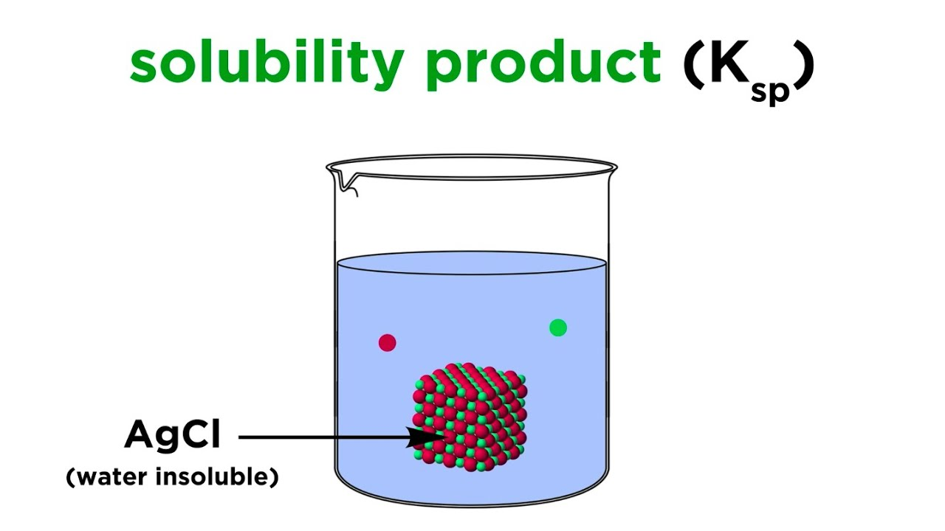
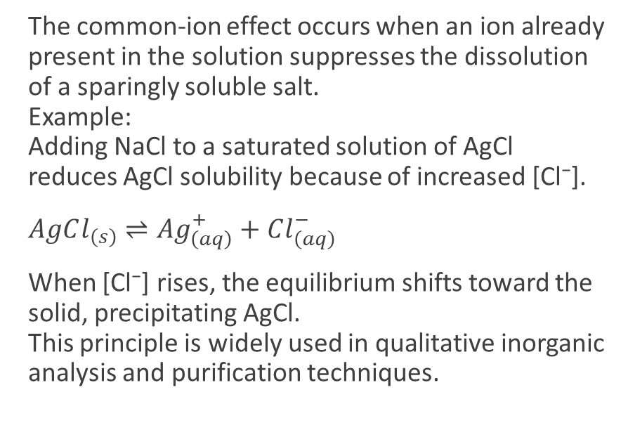
Common-ion effect and precipitation
The common-ion effect occurs when an ion already present in the solution suppresses the dissolution of a sparingly soluble salt.
Example:
Adding NaCl to a saturated solution of AgCl reduces AgCl solubility because of increased [Cl⁻].
$AgCl_{\left(s\right)}⇌Ag_{\left(aq\right)}^{+}+Cl_{\left(aq\right)}^{−}$
When [Cl⁻] rises, the equilibrium shifts toward the solid, precipitating AgCl.
This principle is widely used in qualitative inorganic analysis and purification techniques.

Slide 6
Factors Affecting Solubility
Temperature:
  For endothermic dissolutions, solubility increases with temperature.
  For exothermic dissolutions, solubility decreases as temperature rises.
Common ions:
  Presence of a common ion reduces solubility due to Le Châtelier’s Principle.
pH of the solution:
  For salts containing basic anions (e.g., carbonates), acidic conditions increase solubility by protonating the anion.
Complex ion formation:
  Solubility can increase when ions form soluble complexes.
Solvent polarity:
  Polar solvents favor dissolution of ionic compounds.

Slide 7
Applications
Analytical Chemistry: Used in precipitation titrations and selective ion detection.
Environmental Chemistry: Predicts metal ion solubility in natural waters and soil systems.
Pharmaceutical Science: Determines drug solubility and bioavailability.
Industrial Chemistry: Controls crystallization and purification processes.
Biological Systems: Regulates mineral balance (e.g., calcium phosphate equilibrium in bones).

Slide 8
Summary
Chemical equilibrium in solution is a dynamic balance between dissolved and undissolved phases.
Ksp provides a quantitative measure of solubility and is essential for predicting precipitation and dissolution.
Le Châtelier’s Principle governs how solubility changes with concentration, temperature, and pH.
Understanding solubility equilibrium enables control of industrial reactions, environmental processes, and biochemical systems.
The equilibrium concept links thermodynamics and chemical reactivity in aqueous systems. Mastering dissolution and solubility behavior allows chemists to design efficient reactions, analyze environmental impacts, and develop new materials and pharmaceuticals.

Slide 9

Questions?

